Slide 1


Technical issues

Slide 2

REACH - Zinc Consortium
Consortium membership
  86 effective members (due mergers and resignations)of which 48 registered ZnO
  LoA (Letter of Access) ZnO :
    58 paid since last year
  128 ZnO LoA in total
  LtU (License to Use) : 3 new LtU

Slide 3
REACH - Zinc Consortium - LoAs
SCAS EUROPE S.A./N.V. | Belgium | 10-100t/y
Honeywell Belgium N.V | Belgium | 1-10 t/y
UOP BVBA | Belgium | 1-10t/y
Soleras Advanced Coatings BVBA | Belgium | 1-10t/y
REACH Global Services S.A (OR Entekno) | Belgium | 10-100t/y
GC Europe | Belgium | 1,5t/y
Toyota Tsusho Europe S.A | Belgium | 1t/y
Euro Support Manufacturing Czechia | Czech Republic | <100t/y
Tyco Electronics EC Trutnov | Czech Republic | 7t/y
REACHLaw (OR Upper India Inorganic Industries) | Finland | 10-100t/y
Miyoshi Europe SAS | France | 1.644t/y
TPC SA | France | <10t/y
Edward Bartholomey (OR on behalf of Kobo Products SAS) | France | 10-99t/y
ADEKA Polymer Additives Europe SAS | France | 1-99t/y
3M France SAS | France | 1-10t/y
Grolman S.A.S | France | 10-100t/y
Baerlocher GmbH | Germany | 10-99t/y
KTR Europe (on behalf of Hanil Chemical) | Germany | 100-1000t/y
Tyco Electronics Raychem GmbH | Germany | 3t/y
CRI Catalyst Leuna GmbH | Germany | 1-10t/y
3M Deutschland GmbH | Germany | 1-10t/y
KTR Europe GmbH (OR Sukgyung AT Co) | Germany | 1-10t/y
C.S.B (OR ICL Performance Products) | Germany | 10-100t/y
Carl Bechem GmbH | Germany | 9t/y
Momentive Performance Materials GmbH | Germany | 1-10t/y
REACH ChemConsult GmbH (OR Liquid Fertiliser Pty) | Germany | 1-10t/y
KTR Europe GmbH (OR Duckjin Corporation) | Germany | 1-10t/y
CIRS (OR of Baotou Hongbo Te Technology Co) | Ireland | 1-10t/y

Slide 4
REACH - Zinc Consortium - LoAs
CIRS (OR Jiangsu Shenlong Zinc Industry) | Ireland | 100-1000 t/y
CIRS(OR PT Indo Lysaght) | Ireland | 10-100t/y
CIRS (OR Dongjin Semichem Co) | Ireland | 10-100t/y
Cambridge Environmental Assessments (OR Metal Oksit) | Ireland | 10-100t/y
CIRS (OR PT Citra Cakralogam) | Ireland | 10-100t/y
HH Compliance (OR Lubriplate Lubricants Company) | Ireland | 1-10t/y
Steven Johnson OR Yokohama Industrial Products | Italy | 1-10t/y
Rocca Emma Lia (OR on behalf of GE.M.A.R s.r.l) | Italy | 1-10t/y
REI S.n.c | Italy | 1-10t/y
Luxcontrol S.A (OR TDK Corporation) | Japan | 1,8 t/y
Antaria Europe B.V | Netherlands | 1000t/y
Shin-Etsu Silicones Europe B.V (OR Shin-Etsu Chemical Ltd) | Netherlands | 10t/y
Shin-Etsu Silicones Europe B.V | Netherlands | 10-99t/y
Unicat Catalyst Technologies B.V | Netherlands | 10-100t/y
Grupa Azoty S.A | Poland | <100t/y
TUV SUD Iberia (OR on behalf of Sun Beam Tech. Industrial) | Spain | 10-99 t/y
Zinctimal Spain S.L | Spain | >1000t/y
Sustainability Support Services (Europe) AB (OR Pondy Oxides and Chemicals Ltd) | Sweden | 10-100t/y
The Acta Group EU (OR Vanderbilt Chemicals) | United Kingdom | 10-99t/y
Exponent International (OR Sabic Innovative Plastics | United Kingdom | 1-10t/y
WSP UK Ltd (OR Laird Technologies Inc.) | United Kingdom | 1-10t/y
Caleb Management Services Limited (OR Palmer International) | United Kingdom | 1-10t/y
Envigo Consulting Limited (OR Ishihara Sangyo Kaisha) | United Kingdom | 10-100t/y
Bootman Chemical Safety Ltd (OR J.M Huber Corporation) | United Kingdom | 10-100t/y
Regulatory Facilitation Company Limited (OR Nyacol Nano Technologies) | United Kingdom | 1,4t/y
Tyco Electronics UK | United Kingdom | 60t/y
Chemviron Carbon Ltd | United Kingdom | 1t/y
Lubrizol France SAS (Lubrizol Limited) | United Kingdom | 1-10t/y
Regulatory Facilitation Company Ltd 31 (OR MMG Polymer) | United Kingdom | 1-10t/y
Lanxess Solutions UK Ltd | USA | 1-10t/y

Slide 5
REACH ZnO dossier evaluation - summary
Update Oct 2017
Adaptation of IUCLID to all changes made in CSR
June 1st 2018
July 7th 2018
Submission of comments on DD
IZA to contact registrants concerned for interaction in commenting the DD
All registrants receive the Draft Decision
Adaptation to IUCLID 6

Slide 6
Evaluation procedure
BAuA targets MSC meeting of 4-8 February 2019 which would mean PfA sent to registrants in April

Slide 7
Summary testing strategy HH
Test requested | Conditions when to perform test | Deadline
1. Subchronic Inhalation Toxicity: 90-Day Study (OECD TG 413, latest adopted version updated in 2017) combined with the In Vivo Mammalian Alkaline Comet Assay (OECD TG 489) | Unconditionally | 24 months (3+24=27 months)
2. Combined Repeated Dose Toxicity Study with the Reproduction/ Developmental Toxicity Screening Test (OECD TG 422) | Unconditionally | 24 months (3+24=27 months)

Slide 8
Summary testing strategy ENV
Test requested | Conditions when to perform test | Deadline
3a.+3b. Information on transformation, dissolution and dispersion stability | Unconditionally | 12 months (3+12=15 months)
4. Freshwater Algae and Cyanobacteria, Growth Inhibition Test (test method: OECD TG 201, 2006, EU method C.3) | Unconditionally, selection of test material based on results from 3a and 3b | 9 months (3+12+9=21 months)
5. Long-term toxicity on invertebrates (Daphnia sp.) (test method: Daphnia magna reproduction test, EU C.20/OECD TG 211) | Unconditionally, selection of test material based on results from 3a and 3b. | 9 months (3+12+9=21 months)
6. Long-term toxicity testing on fish; test method: Fish, early-lifestage (FELS) toxicity test, OECD TG 210 | Unconditionally, selection of test material based on results from 5 | 12 months (3+12+9+12=36 months)

Slide 9
Consortium proposal HH
the consortium will compile a list of nano ZnO materials registered
Tests on all ZnO nanoforms (bioaccessibility) to substantiate ion only hypothesis and grouping strategy
Stepwise approach:
  In Vivo Mammalian Alkaline Comet Assay (OECD TG 489) including genotoxicity evaluation in organs proposed in the DD (lung epithelium, nasal mucosal cells, liver, bone marrow), with exposure to representative form(s) of nano ZnO via short-term inhalation.
Based on the outcome of the dissolution testing and grouping, the following might be proposed:
  Subchronic Inhalation Toxicity: 90-day Study (OECD TG 413) combined with the Reproduction/Developmental Toxicity Screening test (OECD TG 421) performed with representative form(s) of nano ZnO.

Slide 10
Consortium proposal ENV & Cons.
the 24 hr screening tests will be performed according to OECD series on testing and assessment Nr 29 (2001) on the identified forms of nano ZnO on the EU market. The forms will be tested as put on the market
The results are expected to provide the basis for
  a) the selection of the nano ZnO forms to be tested under requests 4 and 5; and
  b) to form the basis for the grouping of the nanoforms on the EU market.
Waive testing on stability (omit 3b) – will not bring any significant information
Test on the unicellular green algae according to OECD 201 (request 4) and the crustaceans according to OECD 211 (request 5). Given the documented lower sensitivity of the fish, it is proposed to omit the vertebrate testing on fish (request 6), since this is not expected to provide significant information to address the concern of the DD
the consortium will complete the list of uses and associated nano ZnO content
will provide data on
  (i) routes of exposure
  (ii) operational conditions
  (iii) maximum content of nano ZnO for life cycle of paint, rubber and plastics

Slide 11
Testing-Status of bio-elution work
Current RAAF guidance based on bioavailability of toxic element PER ENDPOINT
Tests on all zinc substances done
  Oral exposure route = gastric fluid (worst case) (results available) – no read across possible, specific testing needed for hydroxide and carbonate
  Dermal exposure route = sweat (results available) => Results allow read-across between the soluble Zn- compounds and between the slightly/insoluble Zn-compounds for the skin related endpoint (skin sensitisation)
  Inhalation exposure = interstitial (results available) and lysosomal fluids (on hold)=> Results allow read-across between the soluble Zn- compounds and between the slightly/insoluble Zn-compounds for the inhalation related endpoints
Results will be integrated in the read across cases of the zinc files

Slide 12
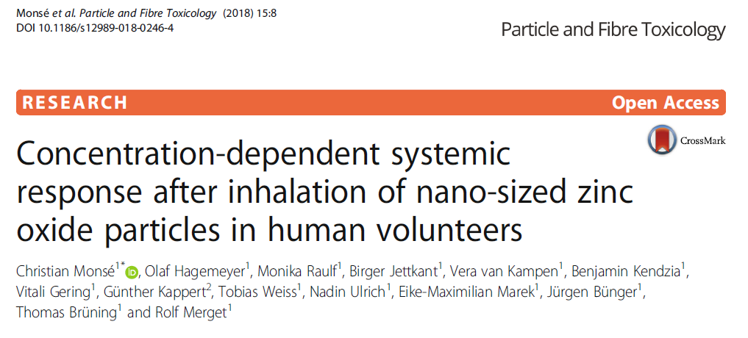
The Human volunteer study at IPA

Slide 13
The Human volunteer study at IPA: conclusions
Study was able to demonstrate
  a concentration-response relationship of ZnO nanoparticles with clear systemic effects at and above 1 mg/m³
The results are in accordance with previous experimental studies that showed
  no effects at 0.5 mg/m³ ZnO
  clear effects concerning CRP with concentrations between 1.1 and 1.5 mg/m³ ZnO-containing welding fumes
A No Effect Exposure Level (NOEL) derived from our study would be defined between 0.5 and 1 mg/m³
Exposure limits of ZnO in many countries (e.g. USA, United Kingdom, Australia, Canada) were set to 5.0 mg/m³ .
As this and more recent experimental studies showed effects far below this concentration, it is highly recommended to reassess the exposure limit for ZnO at workplaces.

Slide 14
OELs and REACH Review 2018
EU Commission intends to reassign the responsibilities of DG Employment's Scientific Committee on Occupational Exposure Limits (SCOEL) to ECHA's risk assessment committee (RAC)
The Commission has been looking into the "interplay" of REACH with EU Occupational Safety and Health (OSH) legislation and more specifically, the "overlap" between OSH occupational exposure levels (OELs) and REACH's derived no-effect levels (DNELs).
“Concrete steps” to remove overlaps between REACH and OSH legislation:
  looking into how to use REACH tools – such as exposure scenarios and SDS – to enhance the effectiveness of OSH legislation
  improving the coordination of national enforcement authorities of REACH and OSH
  aligning methodologies to establish safe levels of exposure to chemicals in the workplace
  enhancing the role of Risk Assessment Committee (RAC), to provide scientific opinions under OSH, with "social partners" also involved

Slide 15
Nano news – EM taskforce
Nano Task Force
Recent regulatory updates | Voted REACH Annexes Amendments of NMs doc’s (04/2018, scrutiny period until 08/2018, Adoption planned 10/2018, full entry into application 01/2020) Revision of Commission’s Recommendation on the definition (August 2018 Consultation) ??? OECD-EU “Malta Project” TGs (2018 starting)
Ongoing actions and follow-up | CARACAL meeting, joint industry statement paper aimed, develop “setting/grouping” of Nanos for an EM position Monitoring of TG development within BIAC Group

Slide 16
REACH revision - annexes
26/04/2018 Annexes have been voted and approved in the REACH Committee
3 Months EP and EC scrutiny, then Commission adoption
Joint statement of Cefic, IMA in June
Without proper definition, legal text is subject to interpretation => nanoform
Guidance is key to interpret properly the new REACH text: workshop in November, work starting

Slide 17
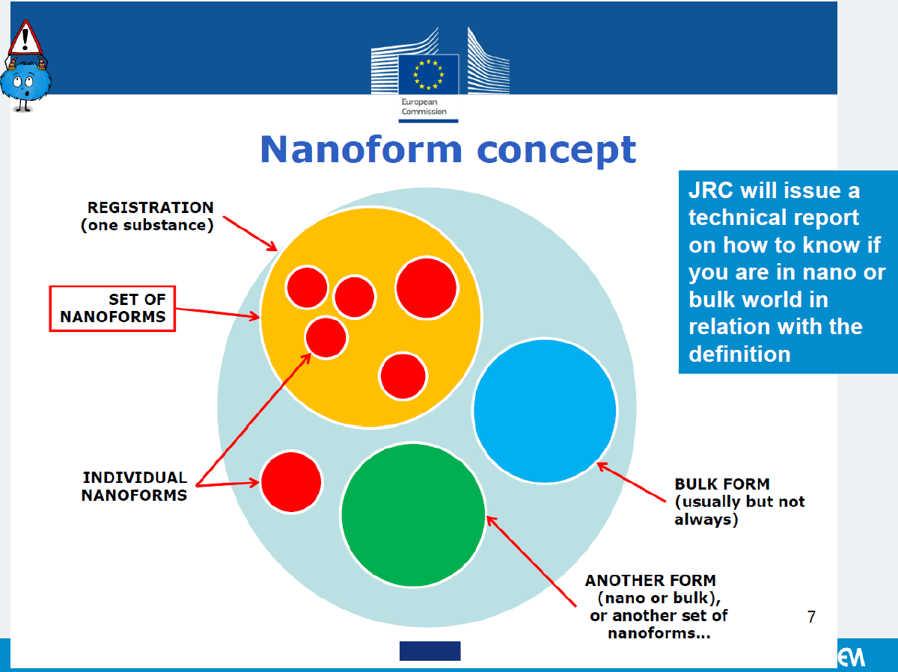
REACH revision - annexes

Slide 18
OECD WPNM meeting – Malta Project
Review of Guidance documents and related Technical guidelines:
6 of 7 projects were approved and notably
  Determination of solubility and dissolution rate of nanomaterials in water and relevant synthetic biologically mediums
  Identification and quantification of the surface chemistry and coatings on nano- and microscale materials
  New TG on Determination of the Dustiness of Manufactured Nanomaterials
  Applicability of the TG 442D in vitro skin sensitisation for nanomaterials
  Aquatic (Environmental) Transformation of Nanomaterials
  New TG on toxicokinetics or Amendments to OECD TG 417 to accommodate nanomaterials
Some discussions ongoing on how to prove negative results

Slide 19
Improving the Zinc files in a Sectorial approach?
By 2020, ECHA wants to have a clear view on registered substances:
  (Seemingly) OK / Further work needed (e.g. because dossier not complete) / Of concern
  evaluation of existing files electronically
It is important to optimise our registration files
  The sectorial approach provides a mechanism to do improvements in formal collaboration with ECHA
  Coordination by Eurométaux - IZA is part of steering Committee
  It is considered positive to work together with the regulators
  REACH process continues (Evaluation, restriction,…)

Slide 20
Proposal: sectorial approach for the inorganic-IZA zinc files
work on improvements, e.g.:
  Read across description: according to RAAF format
  Workplace:
    Update exposure data (respirable fraction)
    new DNEL assessment (?)
  Reformatting exposure scenarios in CHESAR (??)
    Translation in eSDS
  …
1: soluble inorganic zinc substances:
  ZnCl2, ZnSO4, Zn(NO3)2, Zn(H2PO4)2, Zn(NH4)Cl4
2: slightly soluble inorganic zinc substances:
  ZnO, Zn3(PO4)2, ZnCO3, Zn(OH)2
3: insoluble zinc substances:
  ZnS, Zn slags,
4: Zinc metal
  powder and massive form

Slide 21
Priorities and deliverables

Slide 22
Pb metal classified
9th ATP
Pb powder classified as Repr. 1A H360D
What about ZnO?
In ZnO, Pb is present as PbO
PbO is classified in item “lead compounds” in CLP with CL ≥ 0.3%
SCL ≥ 0.03%
exposure is to PbO and it is the compound that should be taken into consideration when classifying and assessing the risk

Slide 23
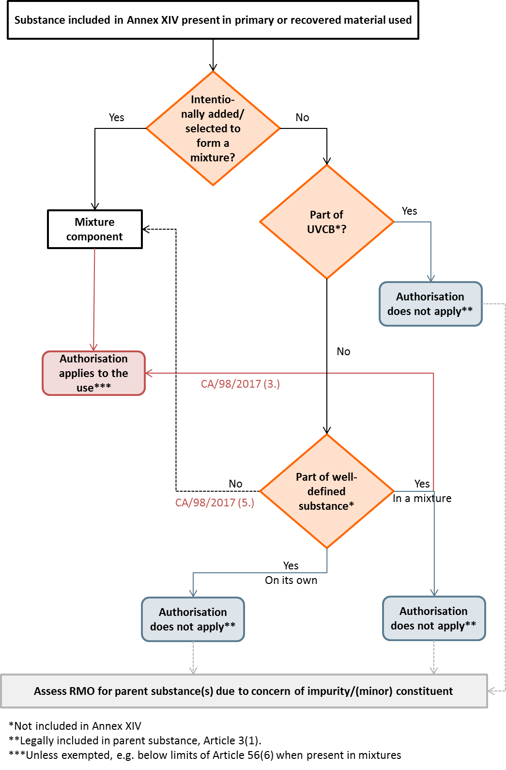
What if Pb in annex XIV?
Authorisation ?
Big debate on legal interpretation of scope

Slide 24
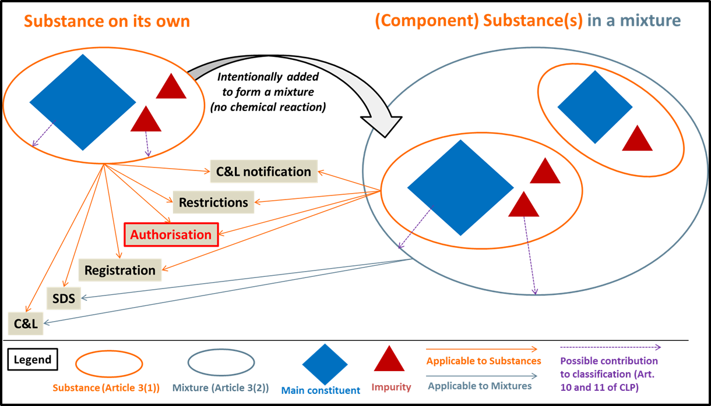
LEGAL INTERPRETATION FRAMEWORK
Article 56(1)(a): ”Substance included in Annex XIV” (Parent Substance)
“Substance” in terms of authorisation means a substance legally defined in Article 3(1), “including any impurity” or other constituent as its integral legal part; it can be suitably called “parent substance”, as opposed to its constituent ‘substances’.
The regulatory logic pursuant to the Parent Substance (“PaS”) concept is, that hazardous constituents of a substance are to be regulated via their parent substance. The PaS concept is generally embodied in the REACH and CLP provisions, including but not limited to authorisation (see Figure).

Slide 25
Zn compounds in oral care
Health assessment of zinc salts in oral hygiene products and toothpaste. BfR July 2014
Public consultation on opinion (deadline May 12, 2017)
COM Request for a scientific opinion (SCCS): Submission I on water-soluble Zinc salts used in oral products
Consumer safety and exposure assessment for zinc in oral care products. Cosmetics Europe. February 2016

Slide 26
SCCS opinion (sub 1)
The final opinion was adopted in plenary meeting of June 2018.
Conclusions are the following
  exposure to water-soluble zinc salts via toothpaste and mouthwash at the concentrations of 1% and 0.1%, respectively, may lead to a daily intake level of 3.54mg for adults and children aged 6-17 years. This exposure constitutes between 14% and 35% of the upper limit (UL) for these age groups. Therefore, the SCCS considers that the use of zinc in toothpaste and mouthwash per se is safe for adults and children aged 6-17 years;
  exposure to water-soluble zinc salts via toothpaste at the concentrations of 1% may lead to a daily intake level of 1.0-2.00mg for children aged six months to five years. This exposure constitutes between 10% and 29% of the UL for this age group. Therefore, the SCCS considers that the use of zinc in toothpaste per se is safe for children in this age group; and
  the SCCS said it cannot advise which portion of the UL should be allocated to exposure from cosmetic products.

Slide 27
WFD: EU Level
Water Conference 2018, Vienna
Status of EU waters today.
  Water Framework Directive reviewed every 6 years.
  Improvements since the last management plan.
Fitness check of the WFD, ongoing:
  Public & stakeholder consultation until March 2019.
  A need to change the Directive (or its implementation) from a metals perspective?
    ‘One out all out’ – hides progress.
    Some confusion over the definition of Ecological Status.
27
Notes:
One out all out – if there is a single exceedance of a priority substance (e.g. Hg, Cd, Pb, Ni) in any part of the waterbody, the whole waterbody fails Chemical Status. So it doesn’t matter if 10 priority substances failed in a waterbody 6 years ago and only 1 today, the waterbody still has the same status = ‘fail’.
Specific pollutants (e.g. Cu, Zn) are part of the Ecological Status; however, it is difficult to link these specific pollutants to ecological effects. Therefore, the consensus is to put specific pollutants in the Chemical Status (makes more sense to me ☺ )

Slide 28
WFD: National level
Member State visits
Promote the use of ‘bioavailability’ and background correction.
These 2 parameters are essential for a correct Environmental Quality Standard (EQS) assessment.
This is an issue!
  Recent European Environment Agency report shows Zn = causing failures in EU surface waters.
So far, IZA has visited Cyprus, Austria, Spain, and Romania.
Biomet tool is a key component in these discussions…
28

Slide 29


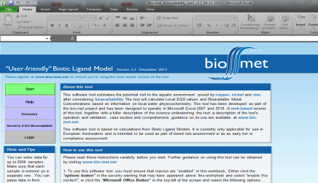
WFD: National level
Biomet
User-friendly tool for assessing the risk of metals in the freshwater aquatic environment, including bioavailability
  Free, online: http://bio-met.net
Currently used for the compliance assessment of a number of metals (Ni, Pb, Cu & Zn).
29

Slide 30
WFD: National level
Zn sheet market pressures.
Some national guidelines dissuade architects from using Zn sheet roofs.
  Primarily due to the ‘Precautionary approach’.
  Their worry = environmental contamination from Zn.
    Unfounded!
Impacting market for IZA members.
In IZA are developing a tool:
  Links [Zn] in roof run-off to an environmental risk assessment.
30
Notes:
Precautionary approach – if you cannot prove ‘no risk’ then project is generally declined…

Slide 31


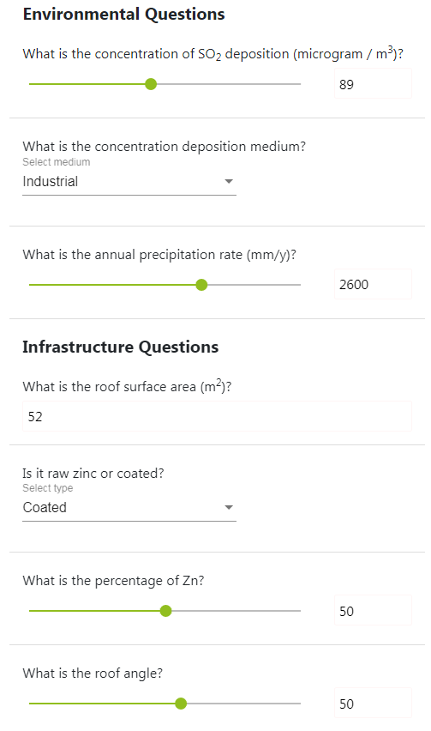

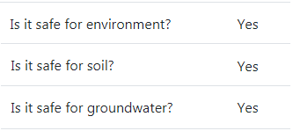

WFD: National level
Zn Roof Assessment Tool for the Environment
31
Notes:
This tool will calculate the total zinc emitted from a roof (for a given surface area and slope) and calculate if there is a risk to the surface water or soil.
Still in development.

Slide 32
Industrial Emissions
Ongoing BREF revision process:
  Common Waste Gas Treatment in the Chemical Sector
Fill-in phase of questionnaire until 21/12/2018
  PbO and ZnO in the scope
  For AT, BE, ES & DE reference plants are chosen
  MS directly exchange with the plants
For the BREF process, we need to be informed by the participating companies
Those who want to join the exercise can still do so
Kick-off meeting report: http://eippcb.jrc.ec.europa.eu/reference/BREF/WGC/WGC_BREF_KoM+IM%20Report%20May18.pdf

Slide 33
Emissions Trading System: implementation phase
ETS is now in its implementation phase. We keep being active on it in several key areas:
  State Aid for Indirects Guidelines: advocacy strategy for improving the rules governing how Member States can compensate industry’s indirect carbon costs.
  ETS Expert Group: Eurométaux Energy and Climate Change Manager, Cillian O’Donoghue, has been accepted in the ETS Expert Group on Climate
Change Policy set up by the European Commission
  free allocation rules now under discussion.

Slide 34
Zinc in Canada - CEPA
Canadian Environmental Protection Act includes environment and health assessments of over 23,000 substances in commerce in Canada, including numerous zinc-based compounds
Under the third phase of the Chemical Management Plan (CMP3), Health Canada and Environment & Climate Change Canada (HC/ECCC) will publish a screening level risk assessment of zinc substances (draft due in early 2019) along with any potential risk management requirements. IZA has been engaged in the CMP process since the zinc group was identified in 2016.
=> Call for input concerning priority zinc compounds
The key risks that would result from a “CEPA Toxic” designation would be risk management requirements to limit the use of zinc/zinc compounds in specific applications in Canada.
Outcomes could also include a declaration of not-toxic with significant activity provisions and/or migration of methods and conclusions to other jurisdictions.

Slide 35
Zinc in Canada - CEPA
Stakeholder meeting will provide industry input/perspective on chemical management, technical product information, and risk assessment
Activity | Schedule
CMP3 Zinc Group Identified | Early 2016
Dialogue with HC/ECCC Initiated | Nov 2016
EU REACH Dossier Shared with HC/ECCC | June 2017
Develop Advocacy Strategy | May/June 2018
Zinc Compound Prioritization | Aug 2018
Develop Zinc Coalition | Aug/Sept 2018
Stakeholder Meeting with HC/ECCC | Late Nov 2018
Draft Zinc Assessment Published | Early 2019
Conclusion-specific Actions | TBD

Slide 36
Communication: website
Comments?
Next steps – communication task force

Slide 37
Membership
Approach Romanian company
  Next steps
  Other ?
Admin update of operating rules needed
  Secretariat will make amendment proposal and submit for validation

Slide 38
Next meeting?
Date: 26-27 September 2019
Place: Sicily (Syracuse)

